Slide 1
iCM 10.0.0.0 – API Server & Forms
Gary Ratcliffe

Slide 2
Agenda
Webinar Programme
API Server
Refresh
Security: Keys & Tokens
Clients
Invoking from a browser
Forms
Invoking API Server
Scripted Actions
Custom form families

Slide 3
Webinar Programme
User
1st October – What’s New in iCM V10
2nd October – Article Editing, Media Upload, etc
3rd October – Preferences, Help Text, Shortcuts
Technical
9th October – iCM V10 Overview
16th October – Forms
13th November – API Server
11th December – API Server and Forms

Slide 4
API Server - Refresh
Platform for:
Delivery of services to support iCM & sites
Forms rendering for all platforms
This is the most obvious difference in initial release
Delivery of secure APIs for 3rd party integration
Secure access to iCM API
Delivery of additional services for iCM and sites: 10.0.1.0
Workflow engine - started
Low level database access - started
Master media image manipulation - started

Slide 5
Architectural Changes – Refresh
Each iCM and delivery server must have a local API Server
Each server must be defined in iCM
iCM sends the configuration information to the API Server
This includes details of database connections, media folder etc
iCM can also send updates to the API Server
Supplied as part of iCM patches or hot fixes.

Slide 6
Using API Server Services
Based on JSON-RPC/2
http://www.jsonrpc.org/
Essentially an HTTP/S POST of JSON Data that represents a function call
Response is also JSON
Multi-part Mime format also support for sending files with requests
JSON-RPC request sent in JSONRPC part
CORS and JSONP Support for cross-site browser requests
http://www.w3.org/TR/cors/
http://json-p.org/
Google Chrome Postman plugin recommended for trying calls

Slide 7
JSON-RPC Examples
Request:
{ "id":"1", "method":"greeting", "params":{"name": "Gary"}, "jsonrpc":"2.0" }
Response:
{ "id": "1", "result": "Hello Gary" "jsonrpc": "2.0", }

Slide 8
JSON-RPC - Request
id
String or number identifying request
method
Name of service method to invoke
params
Parameters, can be an array or object depending on service
jsonrpc
Must be set to “2.0”

Slide 9
JSON-RPC - Response
id
String or number identifying request
result
Simple type, array or object depending on service
jsonrpc
Will be set to “2.0”

Slide 10
Worker Security
Defined in iCM API Server Security
IP Restrictions for workers
Defaults limited to local network or machine
API Keys
Provided for external, 3rd part access
iCM or Site user authentication
HTTP/HTTPS Basic Authentication

Slide 11
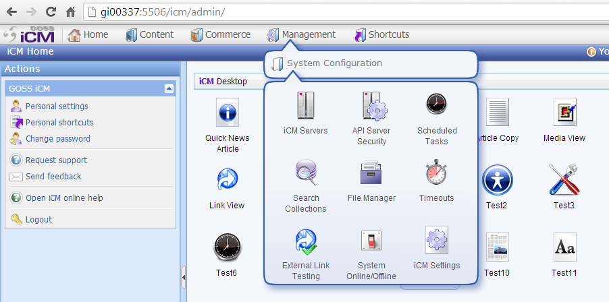
Worker Security

Slide 12
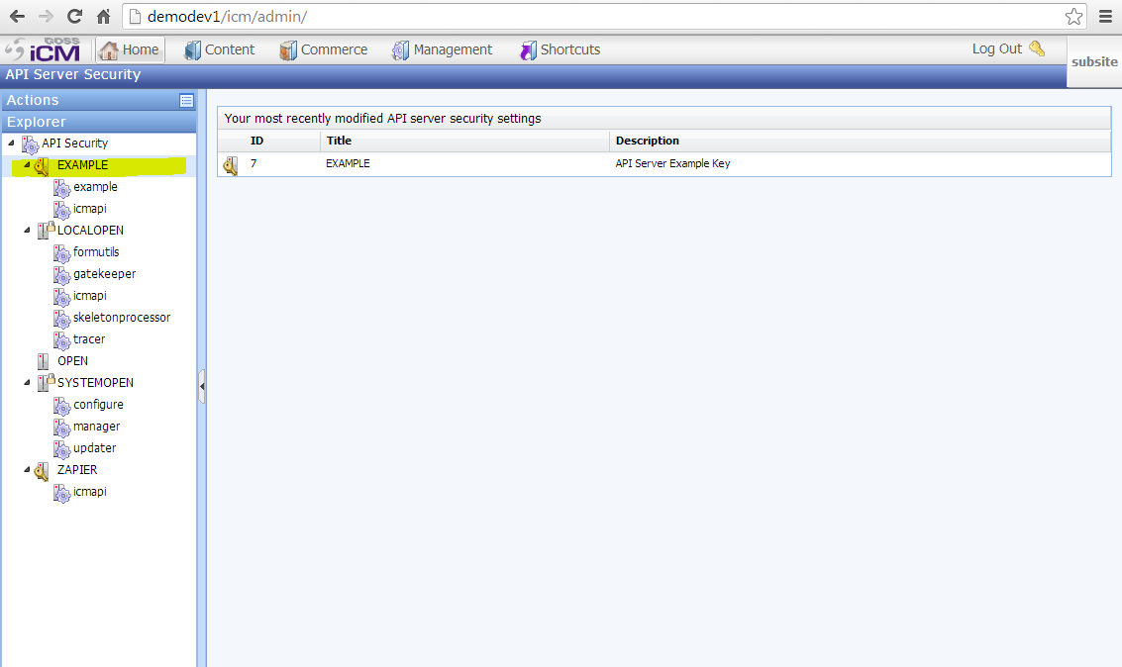
Worker Security

Slide 13
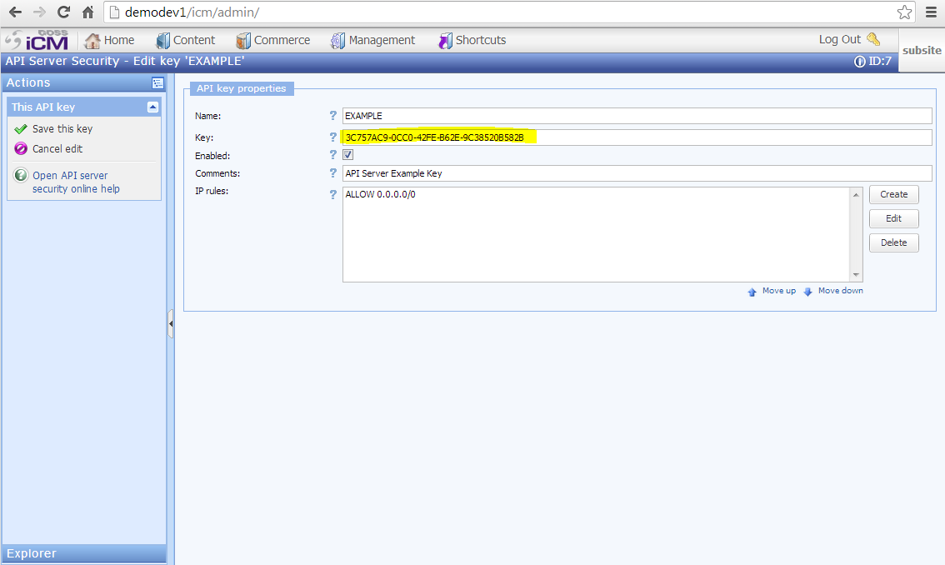
Worker Security

Slide 14
Secured API Server Requests
API Key is sent with request
x-api-key HTTP request header*
API Server checks key and authentication credentials
Encoded using HTTP Basic authentication
API Token returned
x-api-token HTTP response header*
Token as limited lifetime
Normally one hour
Use for multiple API calls in succession
Its quicker for API server to validate a token than a key
Requests sending a token must come from same IP address

Slide 15
Secured API Server Requests with JSONP
JSONP does not allow access to HTTP headers
Its just an HTTP GET
API Key is sent with request
x-api-key url parameter
API Server checks key and authentication credentials
Encoded using HTTP Basic authentication
API Token returned
x-api-token in _transport property of JSONRPC response

Slide 16
Secured API Server Requests
Client
API Server
x-api-key
3C757AC9-0CC0-42FE-B62E-9C38520B582B
x-api-token
E6068B20-63FC-4CAB-9674-BB0F5E08A169
Initial requests
x-api-token
Subsequent requests just supply the token
E6068B20-63FC-4CAB-9674-BB0F5E08A169
x-api-token
E6068B20-63FC-4CAB-9674-BB0F5E08A169
x-api-key
Later request
3C757AC9-0CC0-42FE-B62E-9C38520B582B
x-api-token
7536F9F0-BFD2-448F-959D-FB9277735FDA

Slide 17
API Server Secured Calls
DEMO
Request with API key Requests with API Key & Authentication JSONP Requests

Slide 18
API Server Clients
Java
C#
Coldfusion
Just use cfhttp
JavaScript (browser)
Requires jQuery and supports CORS and JSONP
Client available in server side forms script:
require("apiclient");
Search for apiclient in iCM V10 help text for documentation
Java, C# and JavaScript (browser) will be added to community svn next week

Slide 19
C# Client Example
Java is very similar

Slide 20
Browser JavaScript Example
<script src="scripts/apiserver.js"></script>
.
.
.
<script>
var api;
APIServer.init();
api = APIServer.createApiService( "http://demodev:5706/icmapi", "3C757AC9-0CC0-42FE-B62E-9C38520B582B", null, null, false);
api( "CSArticle_get", { "set" : {...}, "get": "..." }, function( data ){ // Called when response received }, function( resp, errMsg ){ // Called if there is an error } );
</script>

Slide 21
API Server Clients
DEMO
C# Example Browser Sample

Slide 22
API Server and Forms
API Server services can be easily invoked from:
Field ‘default’ function
Scripted Action Handlers
JavaScript library available to help
These are server side requests so security not an issue
Use the apiclient library: require('apiclient');
When using the icmapi the complexity comes from the number of attributes of an article rather than the actual API call

Slide 23
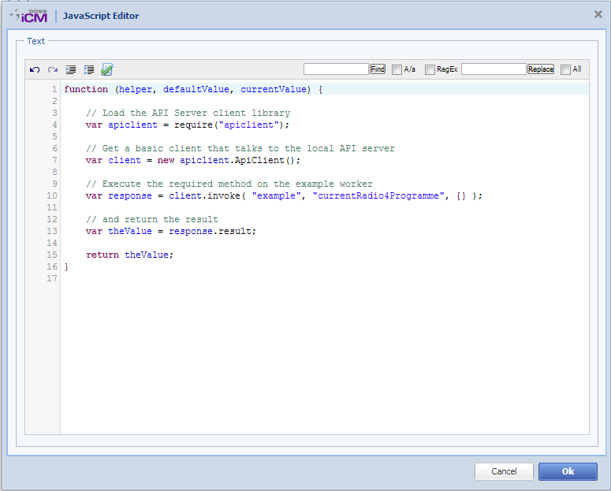
Simple API Server Request

Slide 24
API Server Clients
DEMO
Form Default Function

Slide 25
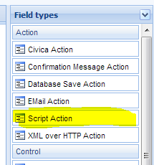
Form Scripted Actions
New field type in V10 to execute server-side JavaScript when a form is submitted
The script is a function that is passed: helper Form helper library processor Reference to skeleton processor props Form properties context Context variables
For most applications only the helper is needed
Remember this is server-side script and never appears in a site users browser

Slide 26
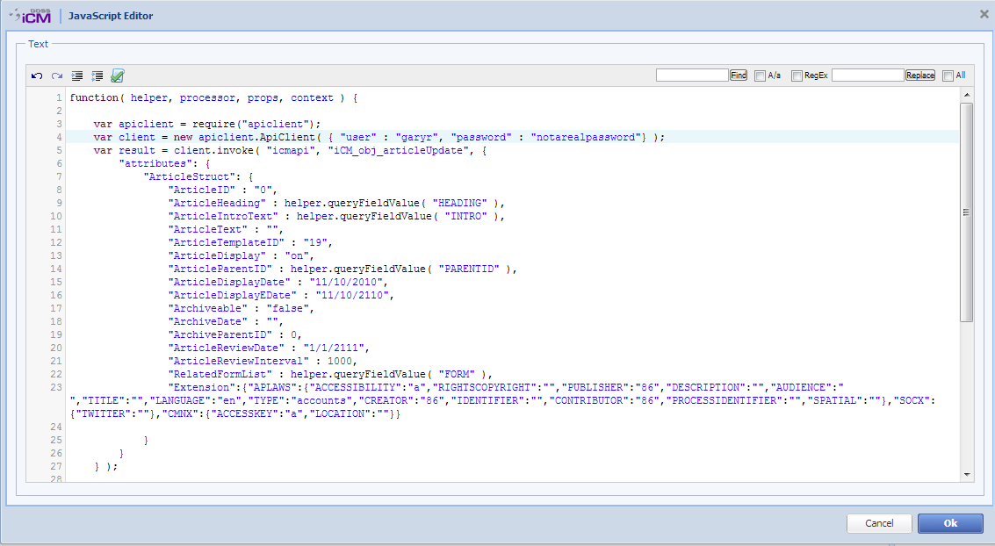
Form Scripted Actions

Slide 27
Form Scripted Actions
Basic request is the same as the simple example. Except:
iCM user name and password required.
Most of the rest of the script is all article attributes
Extra data
helper.queryFieldValue
Use to extract field values

Slide 28
API Server Clients
DEMO
Article Creation

Slide 29
Generating Additional Actions
Helper provides functions for adding and manipulating actions
Scripted action can return a new action. For example a message:

Slide 30
Custom Form Families
Custom form families create in V9 will not be upgraded to V10
We don't know what they are based on so can't process automatically
However there should be a small number of changes needed
Relates to the change from WDDX XML to JSON
Various functions renamed from …WDDX to …JSON
Note that if the custom form family only exists to facilitate the development of custom field types we would recommended recreating its by copying DEFAULTV2
Custom field types that have been copied to the DEFAULT or DEFAULTV2 families should work but we do recommend the field types ObjTypeDefSkel is modified as described to reduce the risk of the problems in the future

Slide 31
Typical Error Report
If you see an error message during form publishing that contains:
You need to check to see if you are using a custom form family and make the changes described.
Any reference to WDDX means the family or field type needs upgrading
Server error: Object # has no method "buildPageTypeWDDX"

Slide 32
Custom Form Families – Affected Skeletons
Form Skeletons
ObjTypeDefSkel
Page Skeletons
ObjTypeDefSkel
Field Types
Field Type Skeletons
ObjTypeDefSkel
Not all field types have this skeleton

Slide 33
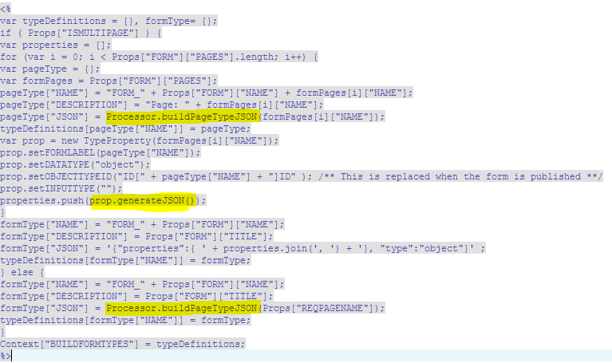
Form Skeletons - ObjTypeDefSkel
Used to be: buildPageTypeWDDX and generateWDDX

Slide 34
Page Skeletons - ObjTypeDefSkel
V9
V10
Suggest this skeleton is copied from the V10 DEFAULT or DEFAULTV2 form family.

Slide 35
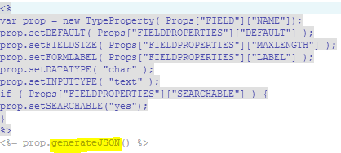
Field TypeeSkeletons - ObjTypeDefSkel
Container field types
Other field types
Used to be: buildFieldTypeWDDX and generateWDDX

Slide 36
Questions?

